Slide 1
Micron Taiwan feasibility study

Slide 2
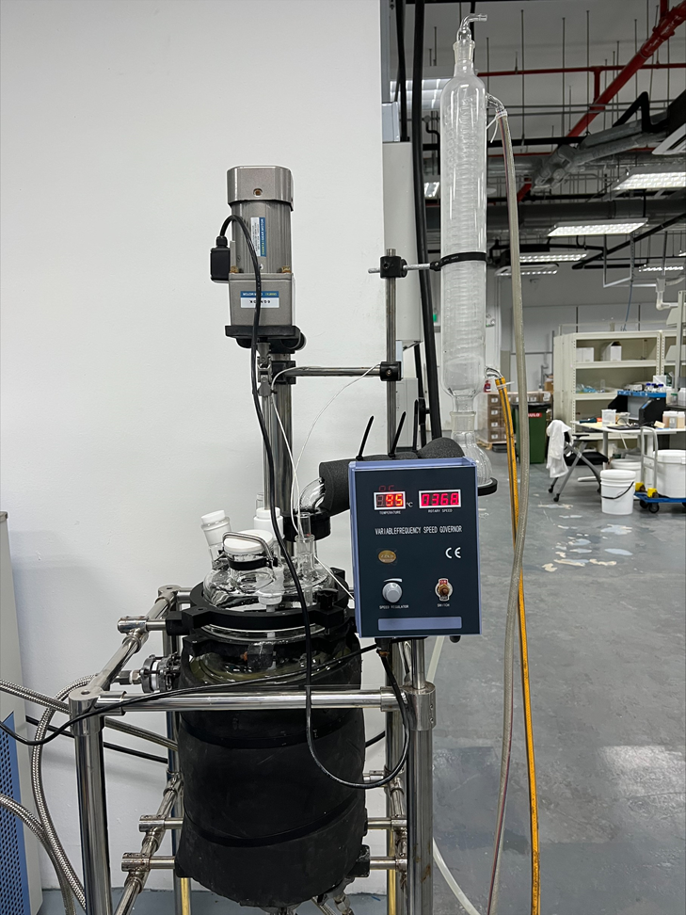
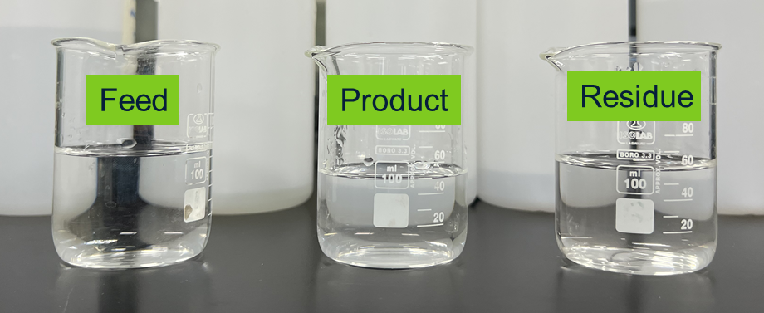
Distillation experiment (stage 1)
Water sample | Composition |  | EC (µs/cm) | TDS (ppm) | pH | Ammonia (NH3) (ppm) | IPA (ppm)
Feed (synthetic water) | Parameters | Value (ppm)
 | Fluoride | 718 | 3848 | 1998 | 10.1 | 2250 | 37083
 | NH3 | 2748
 | IPA | 33131
Feed (synthetic water) | SiO2 | 438 | 3848 | 1998 | 10.1
Bulk condensed | NH3/IPA solution |  | 161 | 76.2 | 11.8 | 9793 | 227083
Residue | N.A |  | 4952 | 2615 | 9.2 | TBC | 1833
Testing condition:
96~99 °C
Mixing rate: 365 rpm
Recovery rate: 11%
Other parameters (Si, F) to be confirmed.

Slide 3
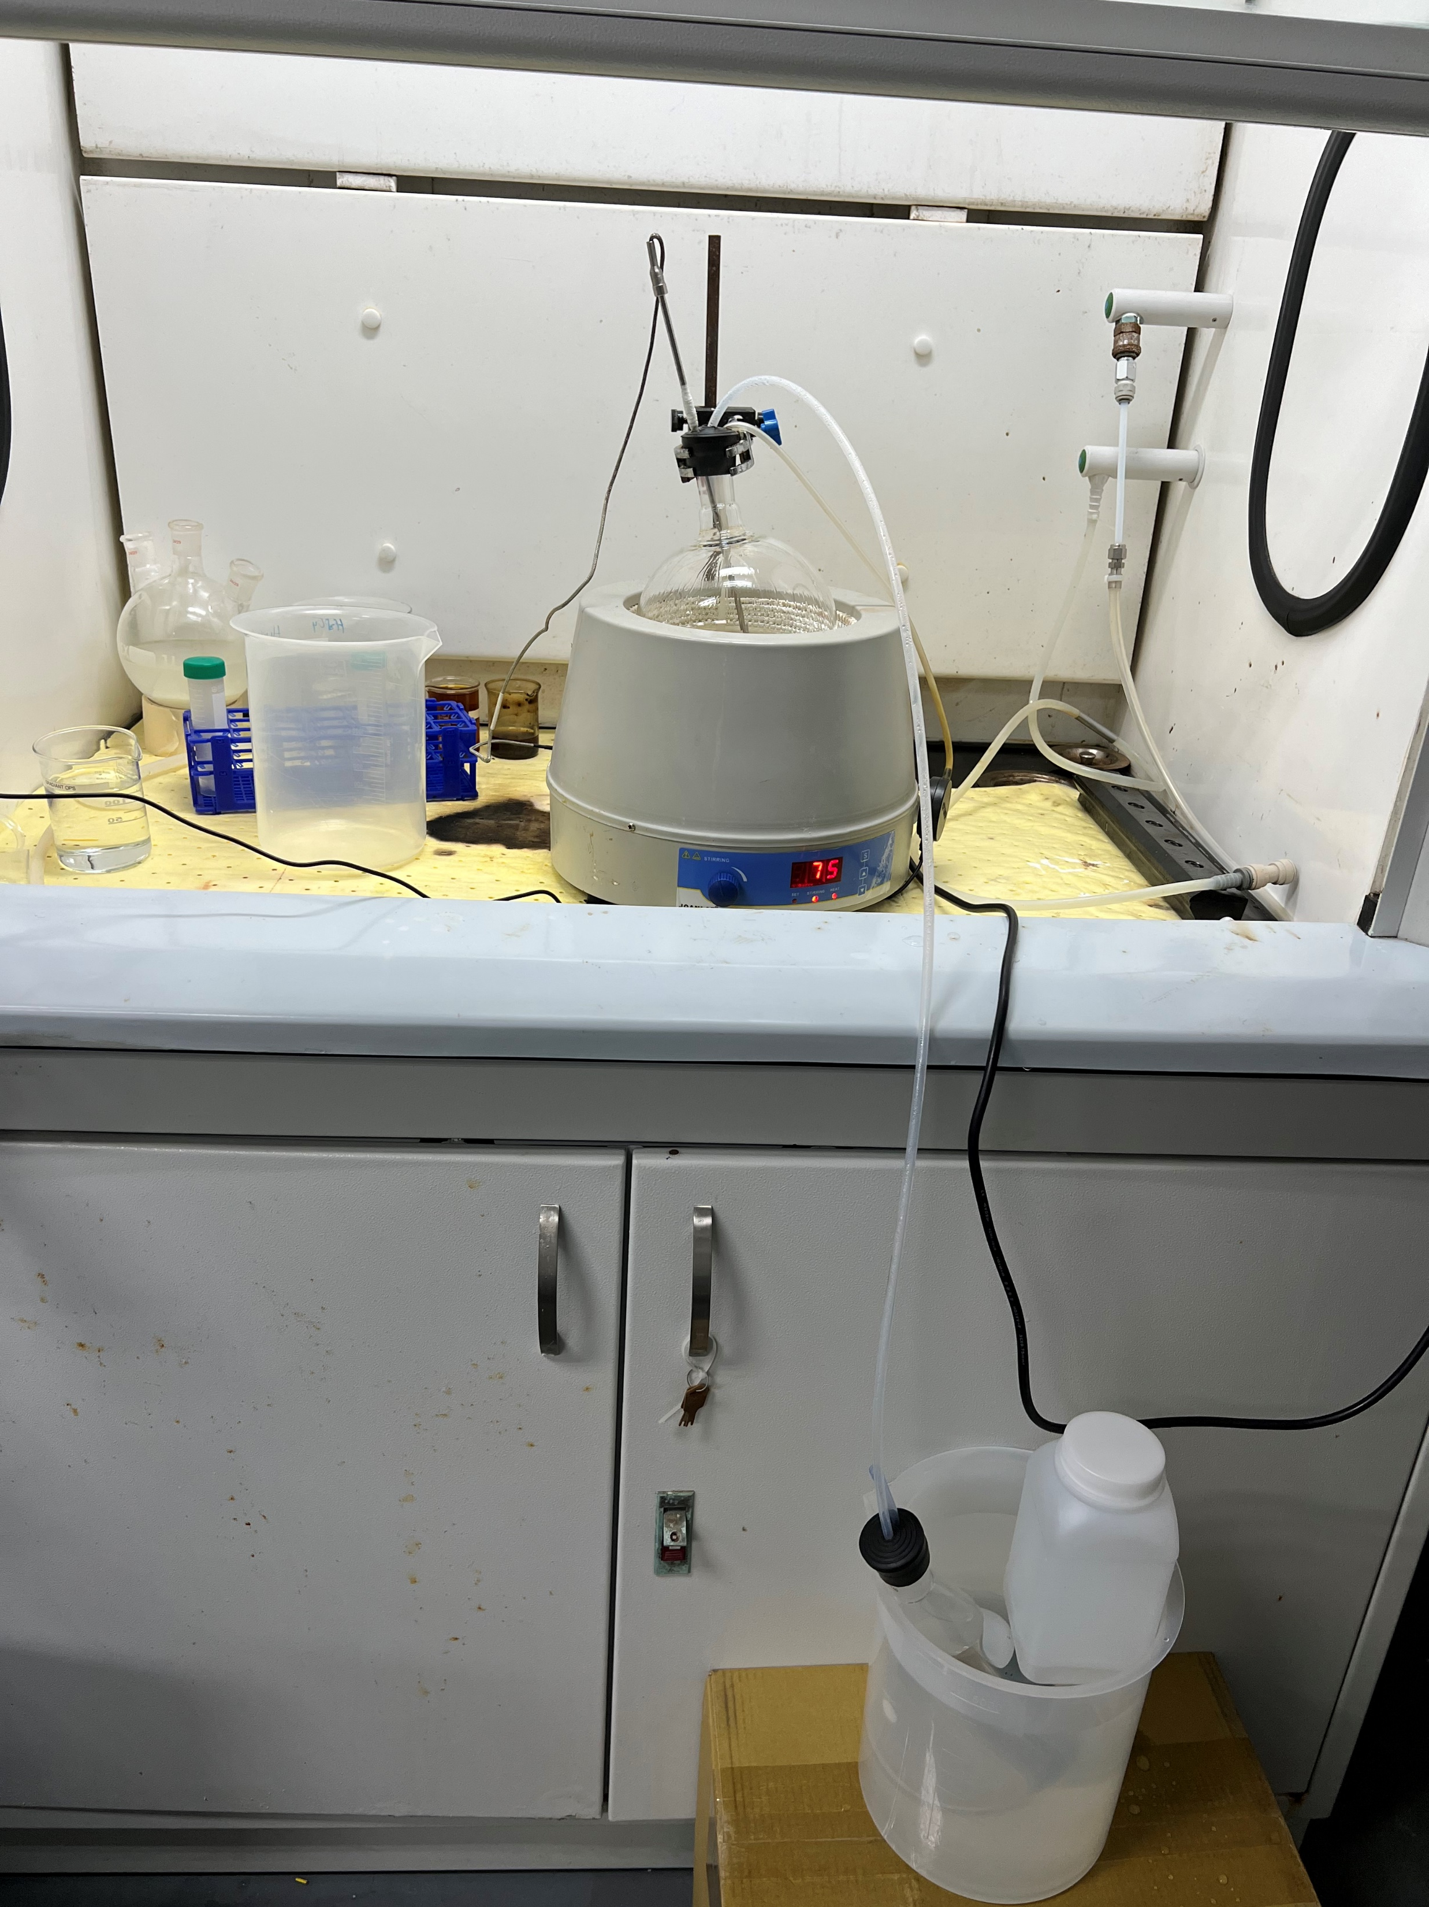
Distillation experiment (stage 2)
Water sample | EC (µs/cm) | TDS (ppm) | pH | Ammonia (NH3) (ppm) | IPA (ppm)
Feed (NH3/IPA condensed) | 161 | 76.2 | 11.8 | 9793 | 227083
Distilled product | 29.1 | 13.58 | 11.8 | 3461 (initial) 65571 (first 2 hours) 19428 (after 4 hours) | > 625000 (first 2 hours)
Residue | 264 | 124.8 | 10.8 | 10746 (at 7% recovery point) | 362500
Testing condition: 75 °C

Slide 4
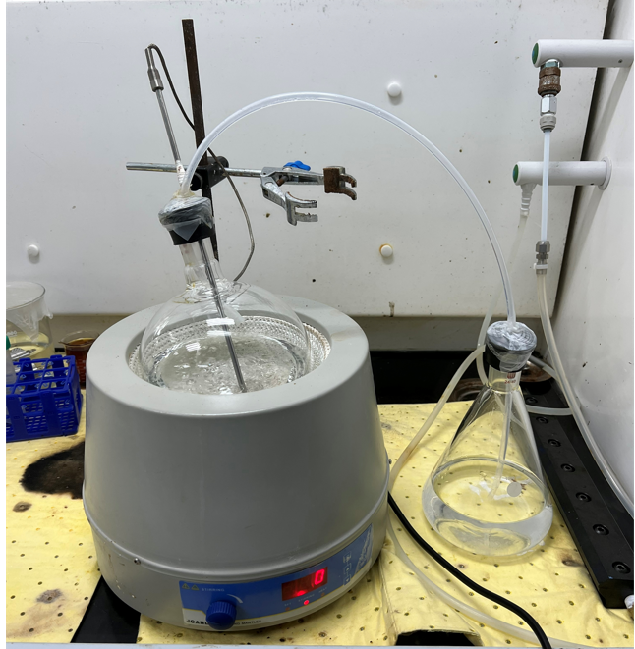
Distillation experiment (stage 2-modified protocol)
Water sample | EC (µs/cm) | TDS (ppm) | pH | Ammonia (NH3) (ppm) | IPA (ppm)
Feed (NH3/IPA condensed) | 161 | 76.2 | 11.8 | 65571 | 625000
Water sample | T (°C) | EC (µs/cm) | TDS (ppm) | pH | NH₃ (%) | IPA (%) | NH₃+IPA dissolved in water(mg)
NH₃/IPA dissolved sample | 60 | 93.6 | 43.9 | 10.6 | 90.5 | 9.5 | 48.3
 | 70 | 90.5 | 42.5 | 10.7 | 84.5 | 15.5 | 59.0
Testing condition: 60~70 °C
Allow NH₃ gas to evaporate and dissolve in a water solution

